Slide 1

Devolutionary Practices and Unique Bureaucratic Structures in Community Supervision
Examining State-Level Variation in All 50 United States
Benjamin J. Mackey, Leah F. Meyer, Catherine Lee, Lynnea Davis, Taylor Hartwell, Shelby Adams, Victoria Hancock, Bryce Kushmerick-McCune, Morgan Moffett, Tumenjavkhlan Sosorburam, Faye S. Taxman

Slide 2
Probation in Context
Devolution in the U.S. Penal System
~3.5 million people on probation in 2019 (Minton et al., 2021)
  Probation can lead to incarceration or impose its own harms on a person (Phelps, 2020; Taxman, 2005)
  Expanded rapidly but evenly throughout the U.S. between 1980 and 2009, with substantial state-level variation in probation rates. (Phelps, 2017)
As probation expands, the state may devolve its penal authority from state, to local, to nonprofit actors (Miller & Purifoye, 2016)
  Carceral Devolution — “a set of interrelated policies that transfer carceral authority—[including] the authority to rehabilitate and supervise prisoners—from federal and state-based institutions to local ones” (Miller, 2014, p. 308)
Notes:
Probation is the most pervasive form of formal penal control (~3.5 million people on probation in 2019) (Minton et al., 2021)
Originally an alternative to incarceration, probation can itself lead to incarceration or impose its own harms on a person (Phelps, 2020; Taxman, 2005)
Expanded rapidly but evenly throughout the U.S. between 1980 and 2009, with substantial state-level variation in probation rates. (Phelps, 2017)
As probation expands, the state may devolve its penal authority from state, to local, to nonprofit actors (Miller & Purifoye, 2016)
Carceral Devolution — “a set of interrelated policies that transfer carceral authority—[including] the authority to rehabilitate and supervise prisoners—from federal and state-based institutions to local ones” (Miller, 2014, p. 308)

Slide 3
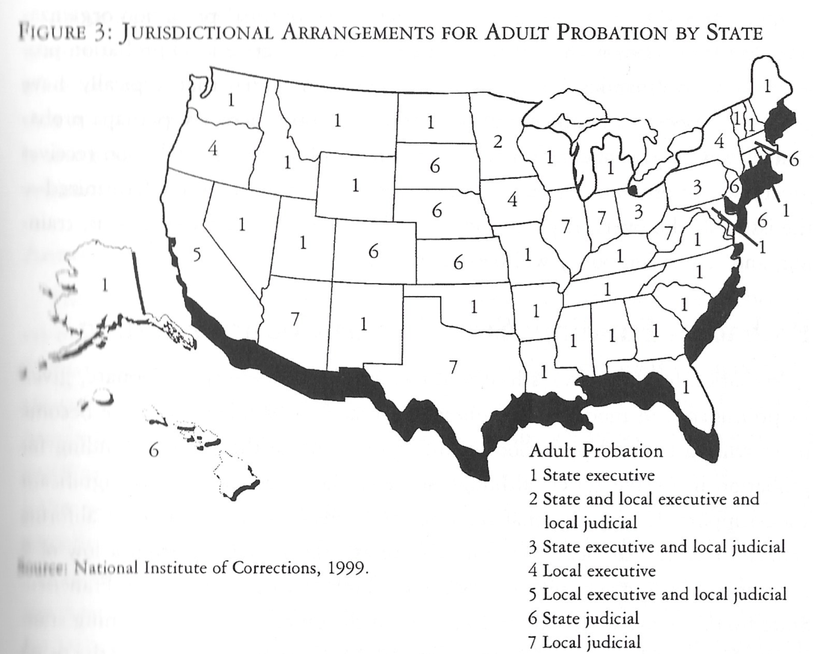
Past Examinations of Devolution in Probation
A 1999 NIC report is the most recent examination of devolution in state probation structures
  Most probation systems (38 of 50) were administered by the state
  A preponderance (18) of probation systems relied entirely on state funds
  Almost all (48) received some funding from the state
Little evidence of devolution in probation services in 1999.
Source: Petersilia, 2002

Slide 4
The Present Study
Jail, Probation, Mental Health, and Substance Use Treatment systems in all 50 United States examined
  Focus of present study on misdemeanor probation to study devolution of services and alignment with other systems
Coded publicly available info from government, nonprofit, and academic websites for multiple variables:
  System administered at state or local level (does state provide direct services?)
  Funding streams available
  Number of jurisdictions within state
  Number of field offices
All states double-coded for fidelity and interrater reliability established via discussion and (if necessary) recoding
Notes:
State provides direct services

Slide 5
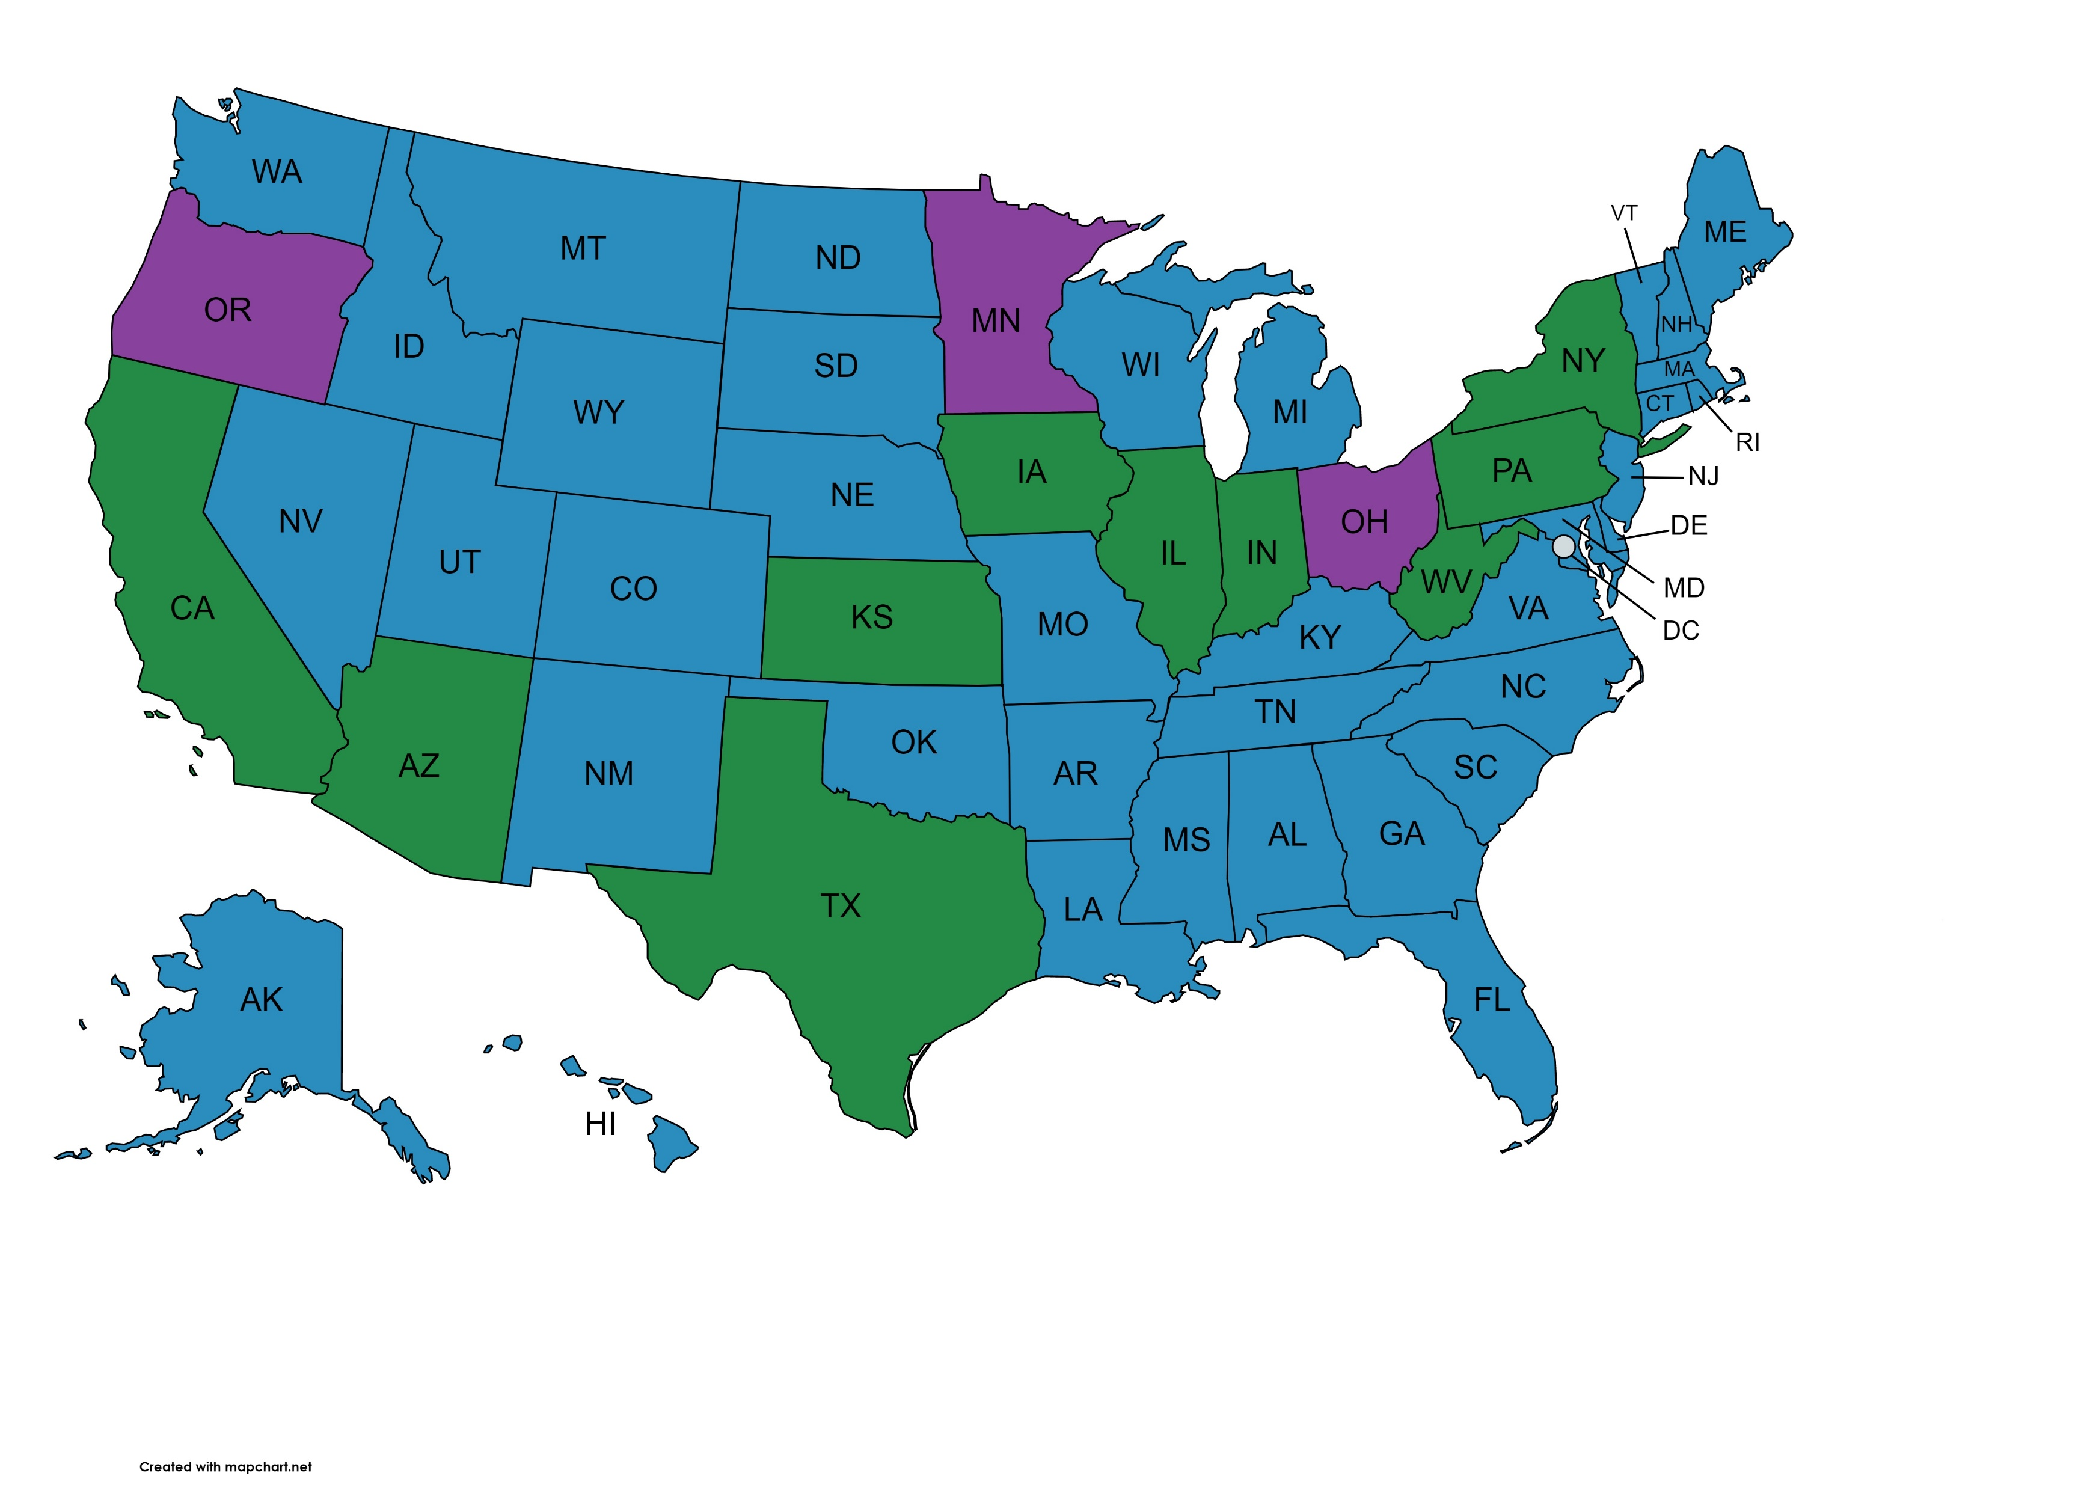
Organization of Probation
State-level administration in majority of states (37)
Local-level administration infrequent (10)
Three states have mix of state and local administration
State Administration
Local Administration
State and Local Administration

Slide 6
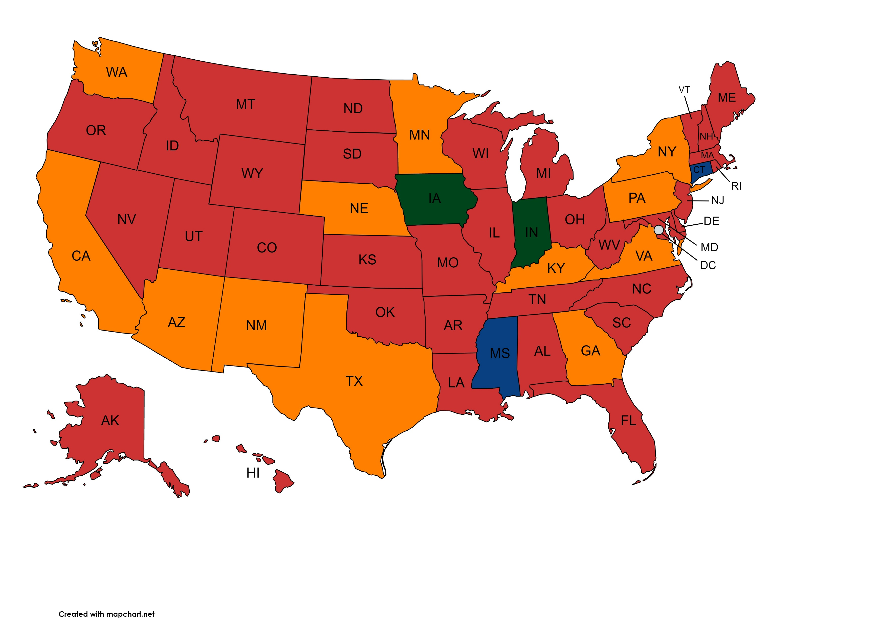
Funding of Probation
State agencies provide funding to probation systems in all 50 states
State funds probation systems even when not administering services directly
Counties provide funding in 14 states
Difficult to determine which states supplement funding with probation fees
State Funded
State and County Funded
State and Private Funded
State, County, and Private Funded

Slide 7
Probation Service Administration
Structure of Service Admin
Geography of Service Admin
 | N | Min | Max | Mean
Offices in State | 45 | 6 | 273 | 52.02
Jurisdictions in State | 36 | 2 | 123 | 20.61
 | Frequency | Percent
Single county | 8 | 16
Multiple county | 16 | 32
Mixed (single+multiple) | 21 | 42
Multiple within county | 3 | 6
State-wide | 1 | 2
Other | 1 | 2

Slide 8
Administration of Penal and Behavioral Health Services in the 50 United States
 | State-Administered | Not State-Administered | Other
Jail | 7 | 43 | 0
Probation | 37 | 10 | 3
Mental Health | 13 | 35 | 2
Substance Use | 15 | 33 | 2
Compared to other penal and behavioral health systems, probation is overwhelmingly administered by state agencies

Slide 9
Devolution vs. Centralized Control
Exceptionalism in Probation?
Theoretical Implications
Policy Implications
Probation could represent an exceptional case, where services have not devolved from state to local level
Or devolution could occur via informal mechanisms unobservable from official sources
State still able to control probation systems and those entangled in them
  Operates via direct administration or provision of funding
Probation systems are often administered by different levels of government than those of other penal or behavioral health systems
  Could complicate efforts to receive clients from jails or refer them to behavioral health services
  Problematic as probation officers often expected to serve both law enforcement and social worker roles (Klockars, 1972; Werth, 2013)

Slide 10
Conclusion
Probation systems in the 50 United States have remained nearly static since 1999– the vast majority remain administered at the state level. Their administration is often quite different from other penal or behavioral health systems.
Devolution may be absent from probation systems, or it may be occurring via informal mechanisms
  Future research necessary to identify these mechanisms
Lack of alignment with other penal and behavioral health systems may complicate transfer and referral efforts

Slide 11
Thank you for listening!
Questions or comments? Great! Please send them to Ben Mackey (bmackey2@gmu.edu)
This study is funded by the National Institute of Mental Health, National Institute of Health (R01 MH118680). All opinions are those of the research team and not of the funding agency.
References
Klockars, C. B. (1972). A theory of probation supervision. The Journal of Criminal Law, Criminology, and Police Science, 63(4), 550–556. https://doi.org/10.2307/1141809
Miller, R. J. (2014). Devolving the carceral state: Race prisoner reentry, and the micro-politics of urban poverty management. Punishment & Society, 16(3), 305-335. https://doi.org/10.1177/1462474514527487
Miller, R. J., & Purifoye, G. (2016). Carceral devolution and the transformation of urban America. In L. S. Abrams, E. Hughes, M. Inderbitzin, & R. Meek (Eds.), The voluntary sector in prisons: Encouraging personal and institutional change (pp. 195-213). Palgrave Macmillan.
Minton, T. D., Beatty, L. G., & Zeng, Z. (2021). Correctional populations in the United States, 2019 – Statistical tables. Bureau of Justice Statistics. https://bjs.ojp.gov/sites/g/files/xyckuh236/files/media/document/cpus19st.pdf
National Institute of Corrections [NIC]. (1999). State organizational structures for delivering adult probation services. Author.
Petersilia, J. (2002). Reforming probation and parole in the 21st Century. American Correctional Association.
Phelps, M. S. (2017). Mass probation: Toward a more robust theory of state variation in punishment. Punishment & Society, 19(1), 53-73. https://doi.org/10.1177/1462474516649174
Phelps, M. S. (2020). Mass probation from micro to macro: Tracing the expansion and consequences of community supervision. Annual Review of Criminology, 3(1), 261-279. https://doi.org/10.1146/annurev-criminol-011419-041352
Taxman, F. S. (2005). Brick walls facing reentering offenders. International Journal of Comparative and Applied Criminal Justice, 29(1), 5–18. https://doi.org/10.1080/01924036.2005.9678729
Werth, R. (2013). The construction and stewardship of responsible yet precarious subjects: Punitive ideology, rehabilitation, and “tough love” among parole personnel. Punishment & Society, 15(3), 219–246. https://doi.org/10.1177/1462474513481720

