Slide 1

Developing Interagency Collaborations Among Criminal Justice and Behavioral Health Agencies
Evidence from a Nationwide Mixed-Methods Study
Benjamin J. Mackey & Faye S. Taxman
George Mason University
ACCJH 2024 – Phoenix, AZ

Slide 2

Welcome!
This work was funded by an award from the National Institute of Mental Health (R01 MH118680,Taxman and Johnson).
All opinions are those of the research team.

Slide 3

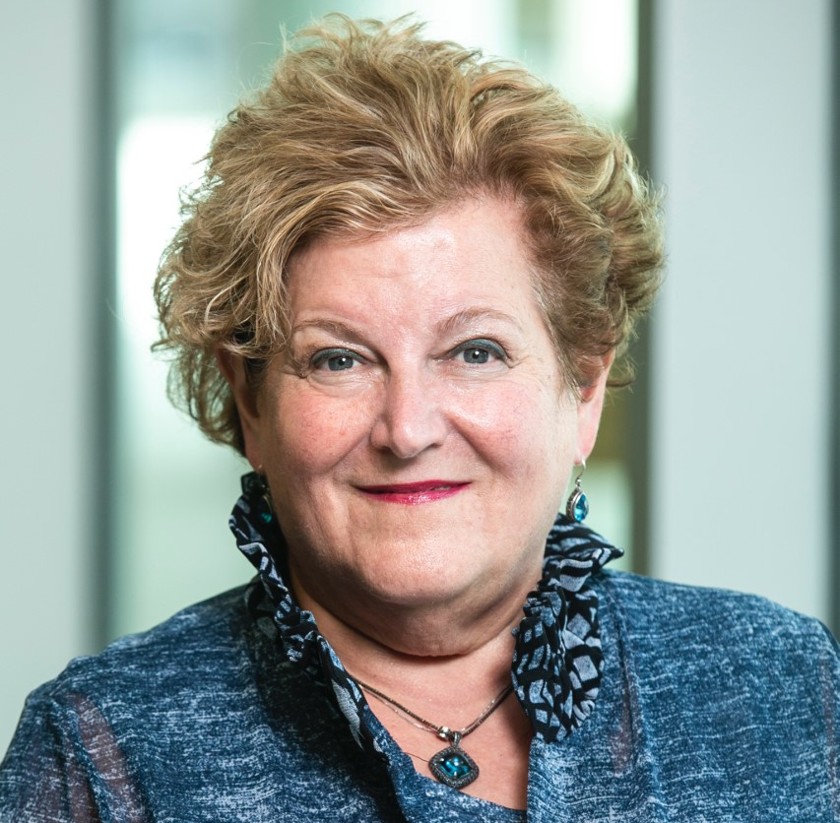
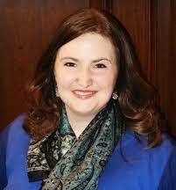
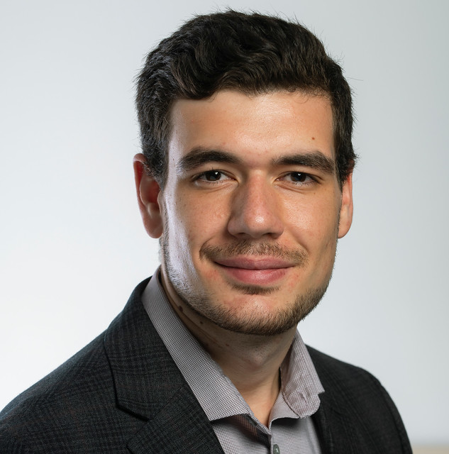
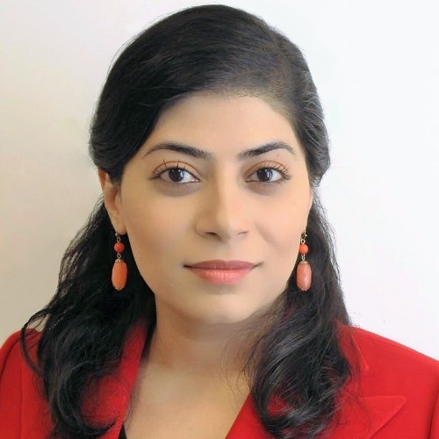
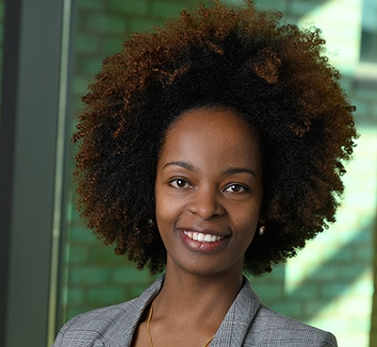
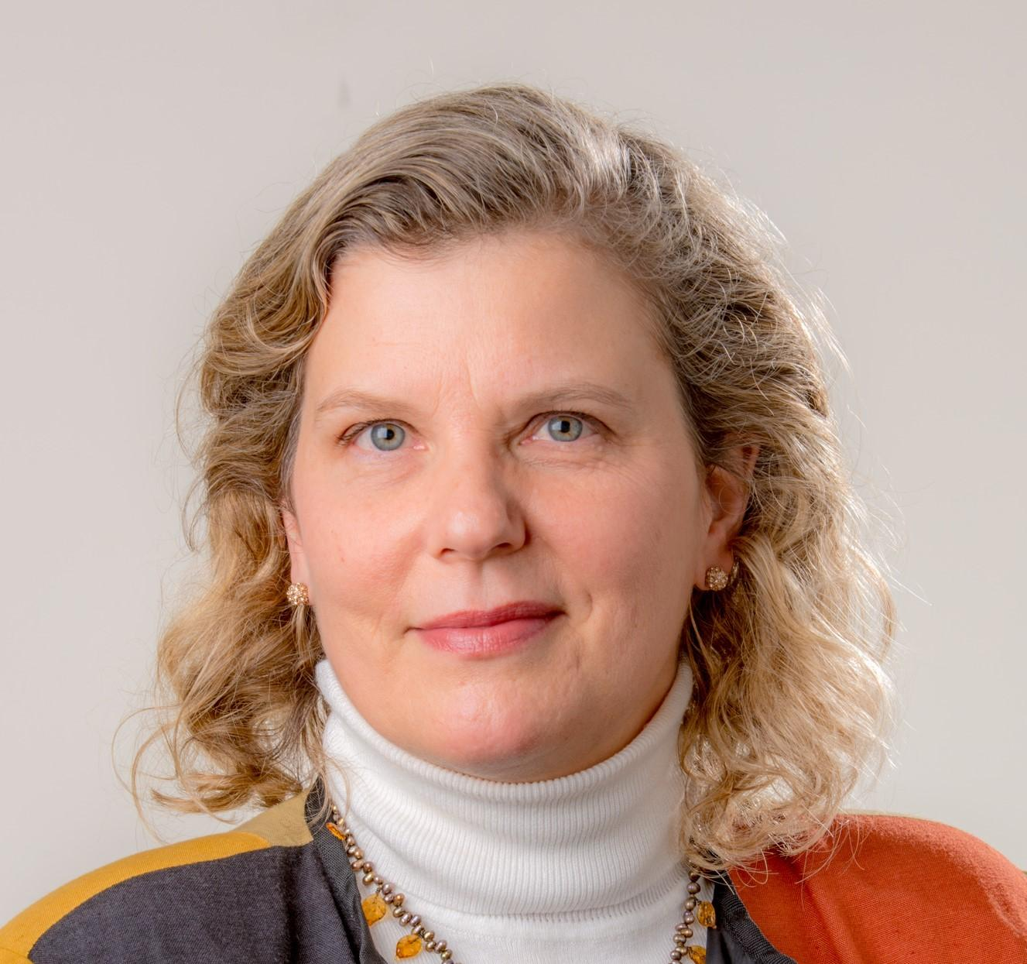
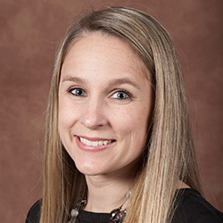

Our Team Includes:
Faye S. Taxman
University Professor | MPI
George Mason University
Jennifer E. Johnson
Endowed Professor | MPI
Michigan State University
Benjamin J. Mackey
Research Associate
George Mason University
Niloofar Ramezani
Associate Professor
Virginia Commonwealth University
Maji Hailemariam
Assistant Professor
Michigan State University
Rochelle K. Rosen
Senior Research Scientist
The Miriam Hospital
Jill Viglione
Associate Professor
University of Central Florida
Teneshia Thurman
Research Assistant
George Mason University

Slide 4

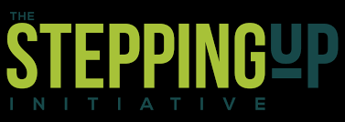
Background
In the U.S., people with behavioral health (BH) conditions involved in the criminal justice (CJ) system at disproportionate rates (Bronson & Berzofsky, 2017; Bronson et al., 2017)
  “High utilizers” – repeated contact with criminal justice, behavioral health, emergency medical, and/or social service systems (SAS Institute, 2017)
The Stepping Up Initiative – National initiative to reduce jail incarceration rates for people with BH conditions
  Counties use their own strategies with assistance
Interagency teams – A key strategy in Stepping Up
and similar reform initiatives
  CJ and BH agencies meet to address high utilizers (Haneberg et al., 2017)
  Evidence-based strategy to achieve system change (Aarons et al., 2014)
  Little known about their inner workings

Slide 5
Our Study – I.M. Justice BH
Focuses on implementation strategies that are mechanisms of Stepping Up
Surveys 4 officials from 475 Stepping Up and 475 matched comparison counties:
Mental health administrator
Jail administrator
Probation chief
Substance abuse treatment administrator
Surveys were planned at study baseline, 18 months, and 36 months
Will result in over 11,000 potential survey responses
  Also 270 qualitative interviews of same officials

Slide 6

Baseline Survey & Interviews (2020-2022)
Survey
Counties (n = 503)
Respondents (n = 758)
Interviews (n = 52)
355 Small (<250k)
100 Medium (250k-750k)
48 Large (>750k)
432 CJ
311 BH
15 Multi-Agency
County Info:
  39 Small
  10 Medium
  3 Large
Primary Agency Info
  31 BH
  21 CJ

Slide 7
Previous Work: Implementation Strategies (Mackey et al., under review)
  Relationship Building Partnerships with other agencies
  Capacity Building Staff capacity and certification
  Quality Programming Evidence-based programming and quality assurance
  Shared Definitions Mutually understood definitions of BH/CJ terms
Relationship Building
α = .908
m = 4.673 (52%)
(# of items = 9)
Capacity Building
α = .770
m = 1.810 (30%)
(# of items = 6)
Quality Programming
α = .866
m = 3.885 (35%)
(# of items = 11)
Shared Definitions
α = .904
m = 1.552 (52%)
(# of items = 3)
* All individual items are Likert-style questions ranging from 1 (“not working on this”) to 4 (“significant progress made”)

Slide 8





Counties that focus on Relationship-Building report more:
Participation in federal CJ/BH grants
Use of evidence-based programs and policies
Use of evidence-based treatments
Participation in national reform initiatives

Slide 9
Research Questions
RQ 1
Who is on Interagency Teams?
RQ 2
What do Interagency Teams do?
RQ 3
What Works in Developing and Sustaining Interagency Teams?

Slide 10

Findings – Who is on Interagency Teams?
Agency | Mentions
Mental Health Providers | 20
Community Corrections | 20
District Attorneys | 16
Judges/Court Administrators | 16
Law Enforcement | 14
Jail Officials | 13
Community Groups | 12
Substance Use Treatment Providers | 12
Social Services | 11
Public Defenders | 10
County Commissioners/Administrators | 7
Medical Providers | 6
Schools/Youth-Serving Agencies | 5
Varied composition creates some conflict
  CJ partners uncomfortable with “social worky stuff” (MH-25)
  “Tread lightly on voicing your opinion as fact” (SU-47)
  “Our local mental health department will drop the people that they've been seeing as soon as they come to jail” (J-39)

Slide 11



Findings – What Do Interagency Teams Do?
Criminal Justice Advisory Board (CJAB)
SUD Teams
(opioids, MAT coalitions, drug courts)
Crisis Response Teams
Assistance with Basic Needs
Often begin with limited focus before expanding to new mission(s) and partners
Collaboration “got [everyone] to the same table, and we started working outside of our siloes” (P-19)

Slide 12
Team-Building Strategies (IVs)
Strategy 2
System integration with other agencies
Strategy 3
Team/consensus building with other agencies
Strategy 1
Learning about/from other agencies
Use local technical assistance to develop staff skills
Identify champions for change in 2 agencies
Participate in activities to learn from other agencies or counties (e.g., site visits)
Promote information sharing
Improve screening and assessment across agencies
Work on “hand off” from one agency to another
Engage in collaborative problem solving
Create a shared vision/goal
Develop consensus of goals and vision

Slide 13
Teamwork Domains (DVs)
Integrated Care
(α = .863)
Data Capacity
(α = .815)
Coordination
(α = .912)
We share general information about populations in need of treatment services.
We use the same requirements to determine eligibility for most mental health and/or substance use disorder services.
We have pooled funding and/or staffing from various agencies to provide mental health services to justice involved individuals.
We share operational oversight of mental health and/or substance use disorder programs/services.
Our organizations provide cross-training for staff on mental health and/or substance use disorder issues.
The agency carries out their commitments we agreed on.
We hold joint staffing/case reporting consultations (except for problem-solving courts, such as drug courts).
We have developed joint policy and procedure manuals for mental health and/or substance use disorder services.
We have modified program/service protocols to meet the needs of other agencies.
We share budgetary oversight of mental health and/or substance use disorder programs/services.
We have written protocols for sharing client information that ensure privacy protections (e.g., HIPAA, 42 CFR 4 part 2.).
We use an electronic health record system that other agencies have access to.
We link data to identify high utilizers or individuals who have previously received services from various agencies.
We have staff training across both agencies related to data collection and analyzing protected information.

Slide 14
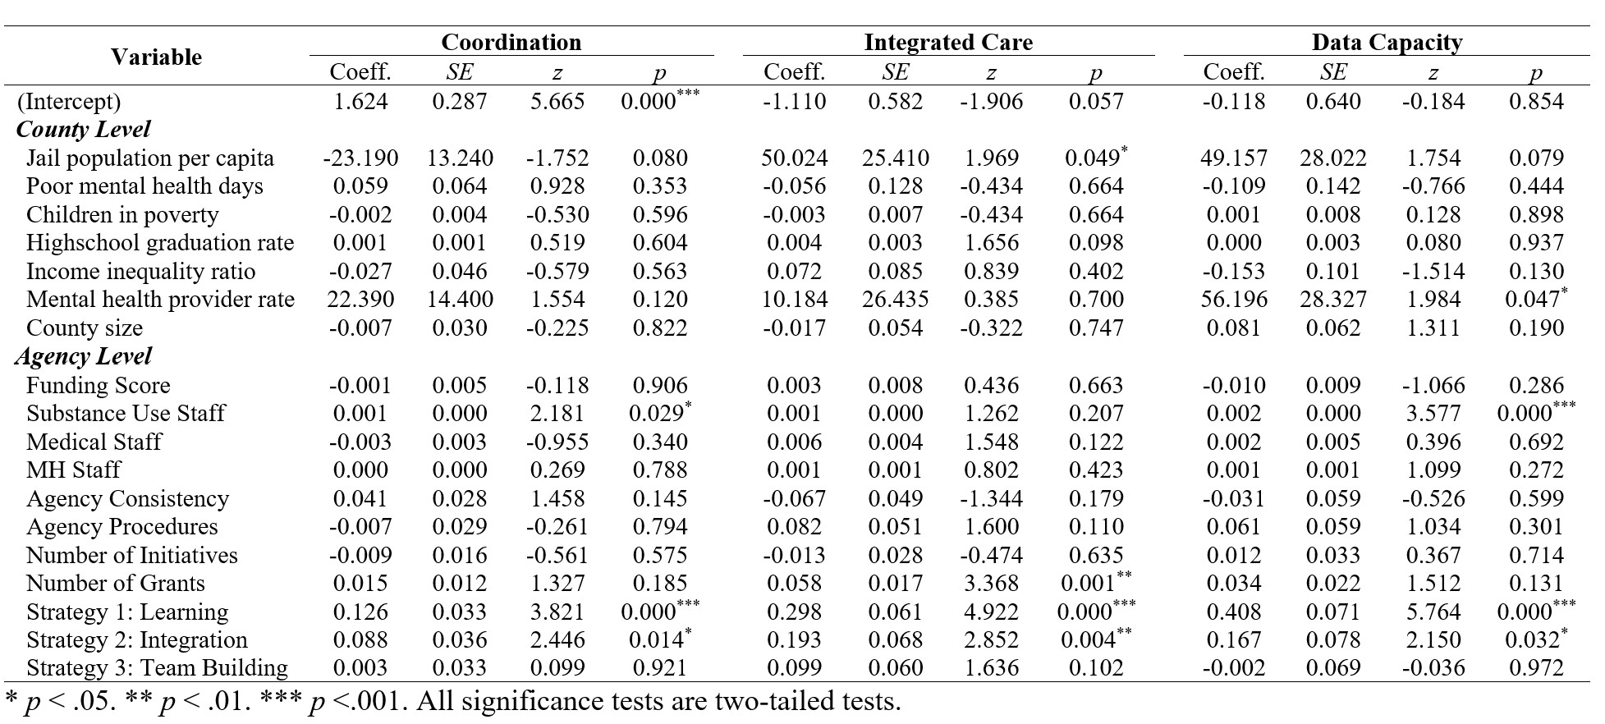
Findings – What Works in Building and Sustaining Teams?
Generalized Hierarchical Linear Models
(family = Poisson; natural logarithmic link function)
Learning about/from other agencies (Strategy 1) and System integration (Strategy 2) significant
Team/consensus building (Strategy 3) NOT significant

Slide 15
Findings – What Works in Building and Sustaining Teams?
Why isn’t Team/Consensus-Building significant?
“The partnerships here […] just continue to get strengthened, but […] I don’t think that that vision or that realization was even known until the coalition was born and we started to come to the table, because we didn’t know what the other entities were being frustrated with. We didn’t know how our actions affected another entity. The communication piece is huge just to be able to sit around a table and talk about what we see.” (J-11)
Collaboration helped agencies learn about and ascertain their frustrations with each other, while identifying what could be improved.

Slide 16
Findings – What Works in Building and Sustaining Teams?
Why isn’t Team/Consensus-Building significant?
“The jail diversion advisory board has been a very effective tool just for keeping communications going. Sometimes criminal justice and social services see the world differently, so being able to problem solve and keep good lines of communication open has been very valuable on that.” (MH-40)
Opening lines of communication through collaboration assisted partners in overcoming some of their longstanding disagreements.

Slide 17
Findings – What Works in Building and Sustaining Teams?
Why isn’t Team/Consensus-Building significant?
Consensus is a product – not a prerequisite – of collaboration

Slide 18
Discussion
Prior research indicates that interagency teams are an evidence-based strategy to achieve system change (Aarons et al., 2014)
Our previous work similarly finds that Relationship-Building is an effective strategy for implementing CJ and BH reforms (Mackey et al., under review)
The current study reveals that:
Teams work on varied projects and are composed of many different agencies
  Can create conflict when mission misaligned with goals of agencies, or when agencies see their activities as conflicting
However, the act of collaboration fosters consensus
  Can help overcome historic disagreements and conflicts
  Consensus on mission not prerequisite to teamwork
    Consensus may be built when agencies work together and learn about each other

Slide 19
Recommendations & Conclusion
Teambuilding 101:
When forming interagency teams, counties should focus on learning about other agencies
Begin with limited mission – don’t attempt to solve all the world’s problems!
Consensus on goals and mission follows teamwork, not vice-versa
  Don’t wait for consensus before working together
Interagency teams remain an important strategy for system change
  Their use should be encouraged by partners and initiatives like Stepping Up
  Conferences, information exchanges, and system mapping exercises all helpful in forging initial links between agencies

Slide 20
Thank you!
Feedback is greatly appreciated :-)
Benjamin J. Mackey
Research Associate
Center for Advancing Correctional Excellence
George Mason University
bmackey2@gmu.edu
Faye S. Taxman
University Professor | Director
Center for Advancing Correctional Excellence
George Mason University
ftaxman@gmu.edu

